Slide 1

Advanced Bash
Will explore advanced Bash scripting techniques including regular expressions, arrays, variables, functions, loops, and script refactoring.
Notes:
1

Slide 2
Topics for today!
1
Regular Expressions
2
Bash variables & parameters
3
Recap: Loops, Conditionals, Functions
4
Arrays
5
Modular scripting & Re-factoring
6
All-in-One Project
Notes:
2

Slide 3
Regular Expressions
  Regular expressions are also referred as "regex".
  These expressions allow validating or extract specific information from the input.
Let's take a common usage of regex in real-world used cases:
Email Validation
IP Address Validation
Matches standard email format (e.g. username@domain.com)
Validates sequence of four numbers (0-255) separated by dots
  Regex: ^\[a-zA-Z0-9._%+-\]+@\[a-zA-Z0-9.-\]+.\[a-zA-Z\]{2,}$
  Regex: ^(\[0-9\]{1,3}.){3}\[0-9\]{1,3}$
  ^[a-zA-Z0-9._%+-]+: Matches the beginning of the string (^), and then looks for one or more (+) characters that can be uppercase letters (A-Z), lowercase letters (a-z), digits (0-9), dots (.), underscores (_), percentage signs (%), plus signs (+), or hyphens (-).
  ^([0-9]{1,3}\.){3}: Matches the first three segments of the IP address. Each segment consists of 1 to 3 digits ([0-9]{1,3}), followed by a literal dot (\.). {3} means this pattern is repeated 3 times, handling the first three parts of the IP address.
  @[a-zA-Z0-9.-]+: The @ symbol is mandatory. After the @, the domain part of the email can contain letters, digits, dots, and hyphens.
  [0-9]{1,3}$: The final part of the IP address is simply 1 to 3 digits, ensuring it ends with a valid numeric segment.
  \.[a-zA-Z]{2,}$: Ensures the domain ends with a period (.), followed by at least two letters (e.g., .com, .org), ensuring a valid domain extension.
Notes:
3

Slide 4

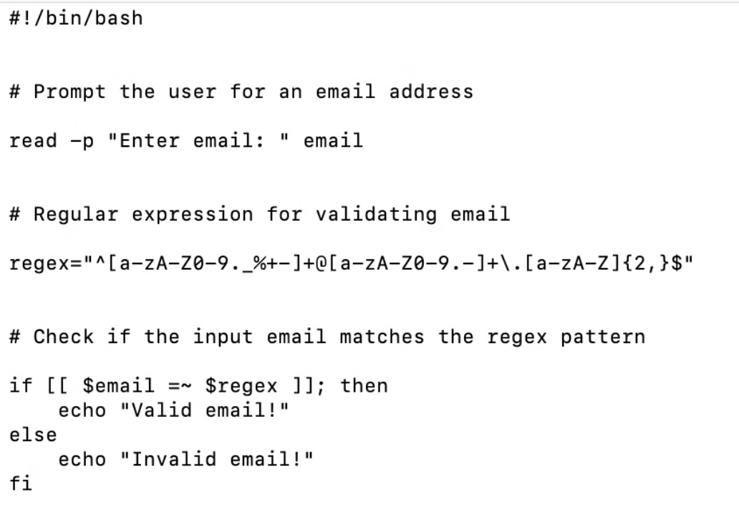

Practical Activity
A simple bash script that validates an email input using the regex pattern.
Notes:
4

Slide 5

Bash Variables and Parameters
Variables & parameters are essential for storing and working with data.
Variables are used to store values that can be used later in the script. [Types: Local & Global]
Parameters are special types of variables that can be used to pass information to scripts or functions.
1
Global Variables
Accessible throughout the script.
2
Local Variables
Only accessible within the function where defined.
Command-Line Arguments
3
Stored in special variables like $1, $2 and passing them while execution.
Parameter Substitution
4
Modify variable values or set defaults.
Notes:
5

Slide 6
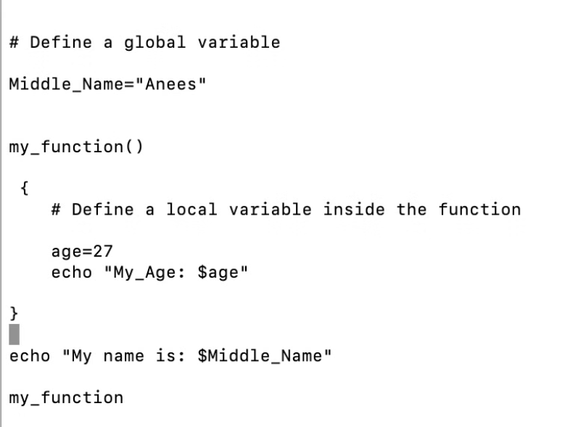
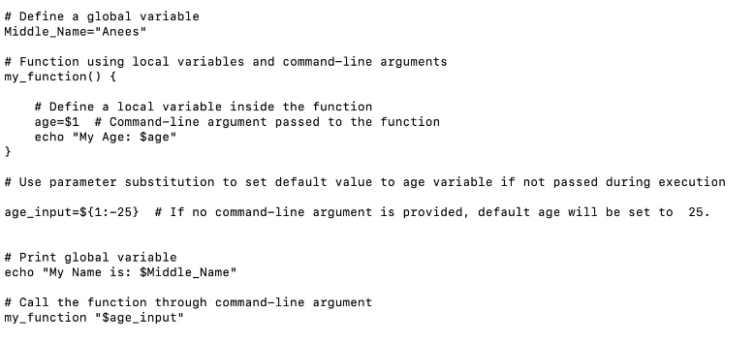
Examples: Variables & Parameters
Using Parameters
Using Variables
Notes:
6

Slide 7







Functions
Define Function
Call Function
Pass Arguments
Return Values
Create reusable blocks of code
Execute the function by name
Send data to the function
Use return keyword or echo output
Conditions
IF
ELIF
ELSE
Executes a block of code if the given condition is true.
Used to check another condition if the previous if or elif condition is false.
Executes a block of code if none of the preceding if or elif conditions are true.
Loops
FOR
WHILE
UNTIL
Iterate over a list or range of numbers
Execute while condition is true
Execute until condition becomes true
Notes:
7

Slide 8

Arrays
Notes:
8

Slide 9
Arrays
  Arrays have a fixed size (like a fixed number of mailboxes in a row).
  Arrays store multiple items of the same type (like storing only letters in all mailboxes).
  Each item in an array can be accessed individually using an index (like opening a specific mailbox).
  Example: If we want to access the 1st item from an array, then we access it using array[0]. (Indexing starts from 0.)
Used cases:
  Managing multiple server upgrades.
  Scaling remote servers using AWS.
  Backup automation for multiple directories.
Types of Arrays:
  Indexed arrays
  Associative arrays
Notes:
9

Slide 10
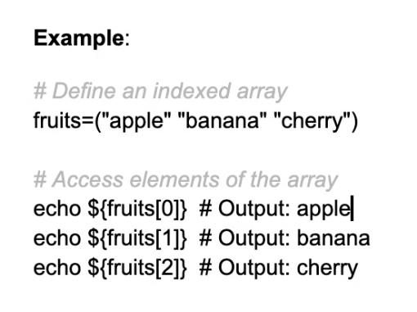
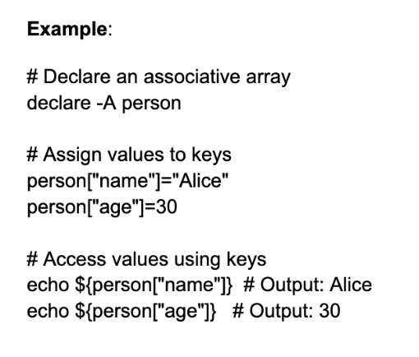
Indexed & Associative Arrays: Example-1
  An indexed array stores multiple elements by numeric index, starting from 0 & an associative array stores values using keys, which can be strings instead of numbers.
  Indexed arrays — used when values are static, associative arrays — used when values need to be dynamic or vary based on specific conditions.
  Indexed arrays: array_name[0]="value"
  Associative arrays: array_name["key"]="value"
Example: Indexed Arrays
Example: Associative Arrays
  The -A flag is necessary to explicitly declare that the array uses keys that are strings, Without -A, the array would be treated as an indexed array.
  It's recommended to use -a for indexed arrays for better script understanding for fellow teammates.
Notes:
10

Slide 11
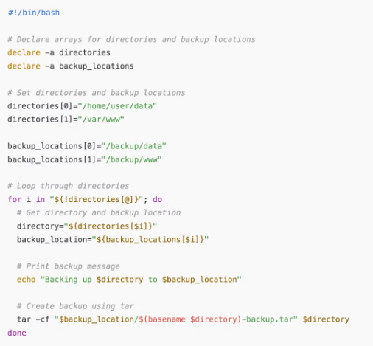
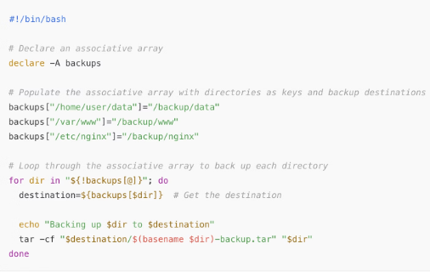
Indexed & Associative Arrays: Example-2
  Let's look into a common example where we can automate the backup of specific directories through arrays concepts using bash scripting.
Associative Array
Indexed Array
Note:
@ is used for accessing values (whole list within array) in both indexed and associative arrays.
! symbol is used in both indexed & associative arrays, but it serves different purposes:
  In indexed arrays, it refers to the indices (0, 1, 2).
  In associative arrays, it refers to the keys (directory paths).
Notes:
11

Slide 12
Polishing your bash scripts!!
Script Refactoring:
  Improving the quality of the existing code.
Identify Repetitive Code
Create Functions
Improve Readability
Optimize Logic
Look for sections that are repeated or similar.
Break down large sections into smaller, reusable functions.
Use meaningful variable and function names, add comments.
Simplify complex conditions, use more efficient constructs.
Make your scripts more robust using: set -e, set -u, set -o pipefail
To prevent unintended behavior and catching errors if any, use above flags right after shebang line in the script.
  Scripts stop on errors (-e).
  Unset variables are caught (-u).
  Pipeline failures are properly reported (-o pipefail).
Modular Scripting with Functions:
  Organizing and structuring code in a way that it can be reused and maintained more easily.
Reusability
Maintainability
Readability
Debugging
Functions can be reused throughout the script.
Easier to update and modify specific tasks.
Improves code organization and understanding.
Easier to identify and fix issues in smaller blocks.
Notes:
12

Slide 13
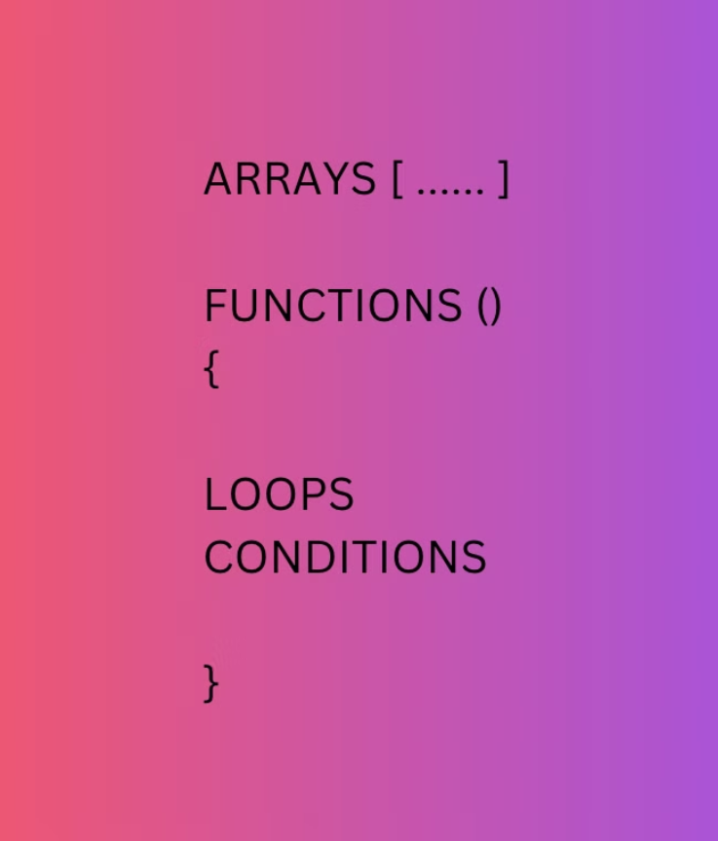
All-in-one: Bash script
Let's analyze a bash script that involves arrays, functions, loops and conditions for installing numerous tools & packages.
Notes:
13

Slide 14

Key Takeaways
1
Regular Expressions
Powerful tool for pattern matching and validation in Bash
Variables & Parameters
2
Variables store data, and parameters allow passing values to scripts or functions for dynamic behavior.
3
Indexed & Associative Arrays
Indexed arrays use numeric indices for ordered data, while associative arrays use custom string keys to store and retrieve key-value pairs.
4
Enhancing your scripts
Refactoring improves script structure and readability, while modular scripting organizes code into reusable functions for better maintainability.
Notes:
14

